Slide 1
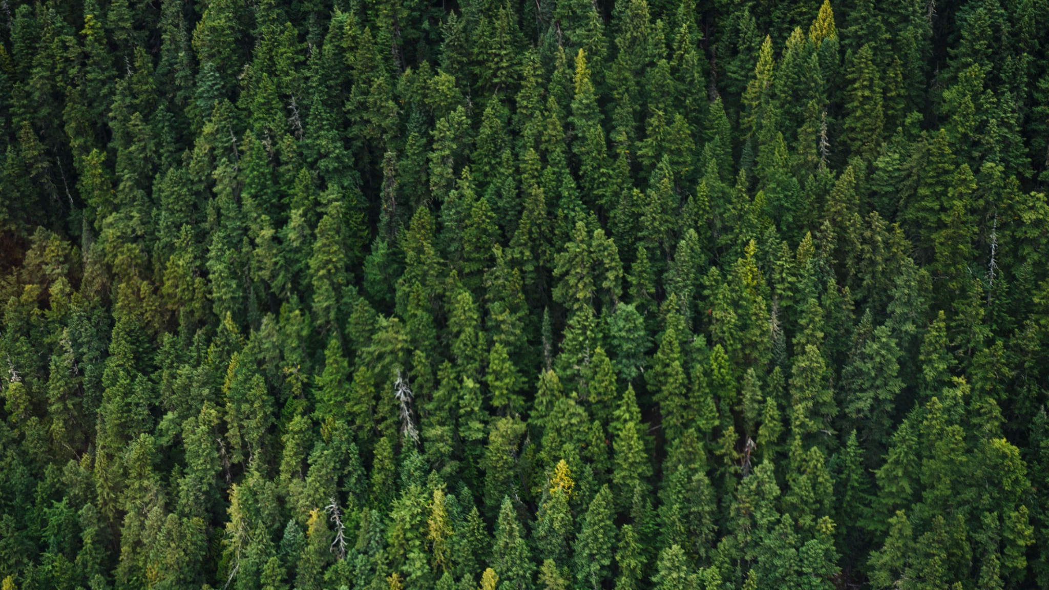
Sheep Detection
The use of UAVs and image recognition in identifying livestock
UAV Ground School Skill Booster 5

Slide 2
Executive
summary
Intro/Why Use UAVs?
Ways of detection
Results
Section
Section
12
⬤ What are some benefits?
⬤ What are some problems?
⬤ One-stage detection
⬤ Two-stage detection

Slide 3
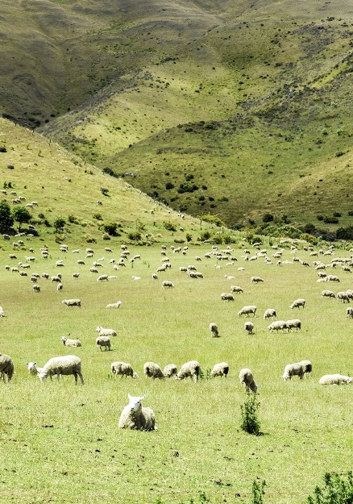
Benefits
Obstacles
Section
Section
12
Sheep Farming and UAVs
-Prevent sheep theft
-Cheaper than spending money on tracking collars or something
-Buy once vs. buy for each
-Much faster/easier than physically counting
-Pics taken at height where you can see the whole paddock (to minimize sheep moving in between passes)
-But, at that height it can be hard to distinguish sheep because they’re so small
-ideal height < 80 m, but pics for this paper taken at ~120 m

Slide 4
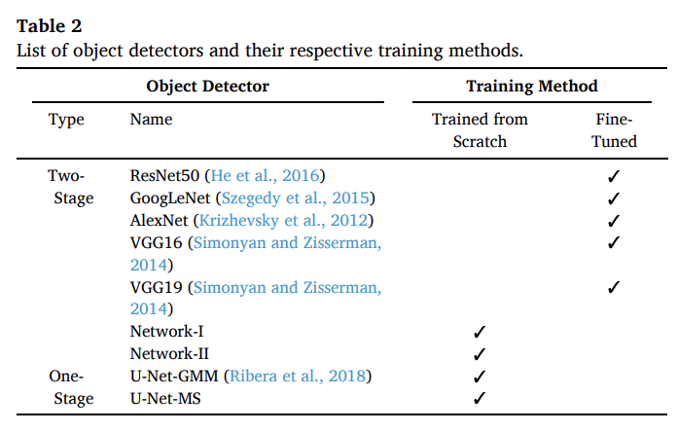
2. Methods/Testing
Section
Section
12
One-Stage Detectors
-YOLO, SSD
-Faster, but more false-positives
-Better for real-time applications
Two-Stage Detectors
-Network I and II
-...There’s a lot of math going on back here that really went over my head but you’re free to check out the actual paper to see it
-Videos were taken at 80 m and 120 m, and images were taken from those at a resolution of 4096 × 2160 pixels.
-images then downsampled into 256 x 256 pixels and divided for training, validating, and testing data sets
-used image stitching to create full frames of sheep

Slide 5
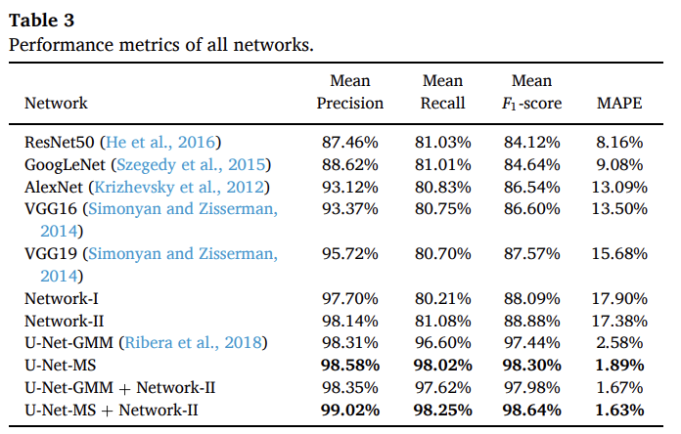
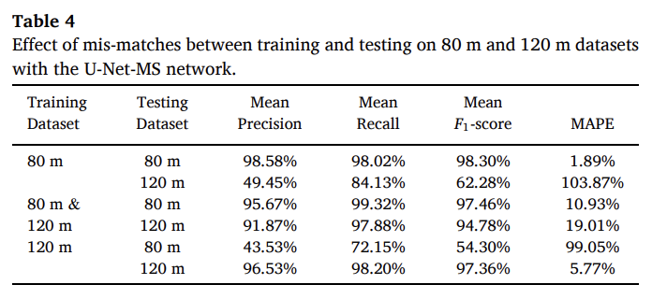
3. Results/Discussion
Notes:
-80 m performed better than 120 m, as 120 m also included object like trees and fences
-legal limit of flying at 120 m
-U-Net performed better on cloudy days, sheep can blend into the reflected light on grass on sunny days
-limitation of time, takes time to compute, so limits real-time applications
-performs worse when sheep clumped together, but they naturally spread out anyway
Performance at 80 m

